Slide 1
CSE 2451 Variable Scope
Zichen Zhang

Slide 2
Overview
Scope definition
Name spaces
Block scope
File scope
Single-file program
Multiple-file program
Function scope
Function prototype scope

Slide 3
Scope
Each identifier that appears in a C program is visible (i.e., can be used) only in some region of the source code, this visible region is called the identifier’s scope
C has four type of scopes
Block scope
File scope
Function scope
Function prototype scope (detail in function slides)
Notes:
Source: https://en.cppreference.com/w/c/language/scope

Slide 4
Scope – name space
When an identifier is encountered in a C program, a lookup is performed to locate the declaration that introduced that identifier
C allows more than one declaration for the same identifier to be in scope simultaneously if these identifiers belong to different categories, called name spaces:
Label names
Tag names (used for struct, union, and enum types)
Member names (member of struct or union types)
All other identifiers – ordinary identifiers (distinguished from the above 3 spaces):
object names
function names
typedef names
enumeration constants
When assigning identifiers/names to entities, we need to avoid name collision within the same name space, i.e., entitles belong to the same name space and are in the same scope need to have different identifiers, otherwise mechanisms of nested scope starts to kick in

Slide 5
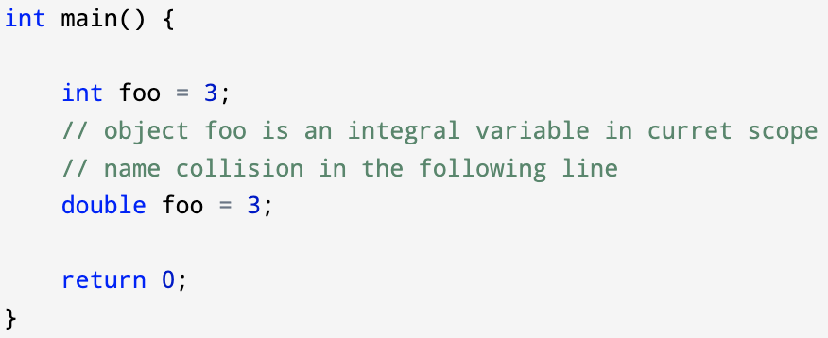
Scope – name spaces - example
Entities of the same name space would have name collision if
they have the same identifier
they are in the same scope
Identifier foo is already taken by int foo = 3;
“double foo = 3;” will directly cause a name collision with existing identifier (int foo) belonging to the same scope, and both entities are variable object in the same name space
Name collision, but no nested scopes, won’t compile properly

Slide 6
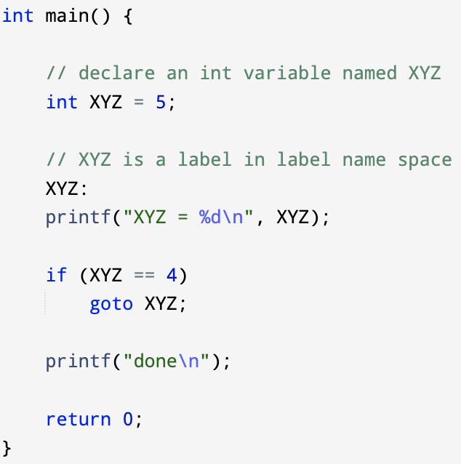

Scope – name spaces - example
Entities of the different name space would not have name collision even if they have the same identifier and are in the same scope
XYZ is declared as the identifier for an integral variable
XYZ is also used as a label for goto statement
But there won’t be a name collision because variable XYZ and label XYZ belong to different name space

Slide 7
Block scope
The scope of any identifier declared:
In a compound statement, including function bodies
In any expression, declaration, or statement appearing in if, switch, for, while, or do-while statement (since C99)
In the parameter list of a function definition
Block scope begins at the point of declaration and ends at the end of the block or statement in which it was declared:
If, switch, for, while, and do-while statement may have declaration of variables inside

Slide 8
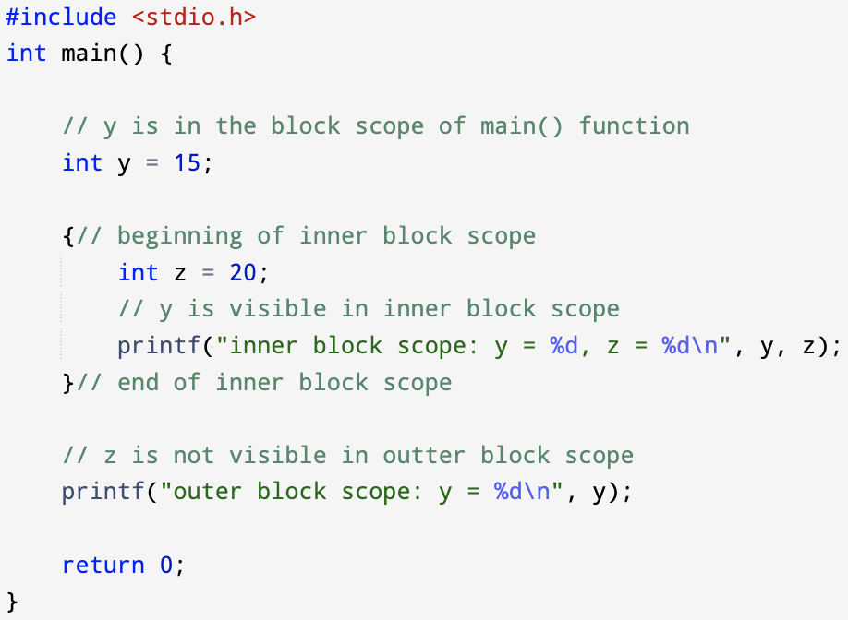
Block scope - example
The simplest form of block scope is introduced by a pair of braces { }
scope of y
scope of z

Slide 9
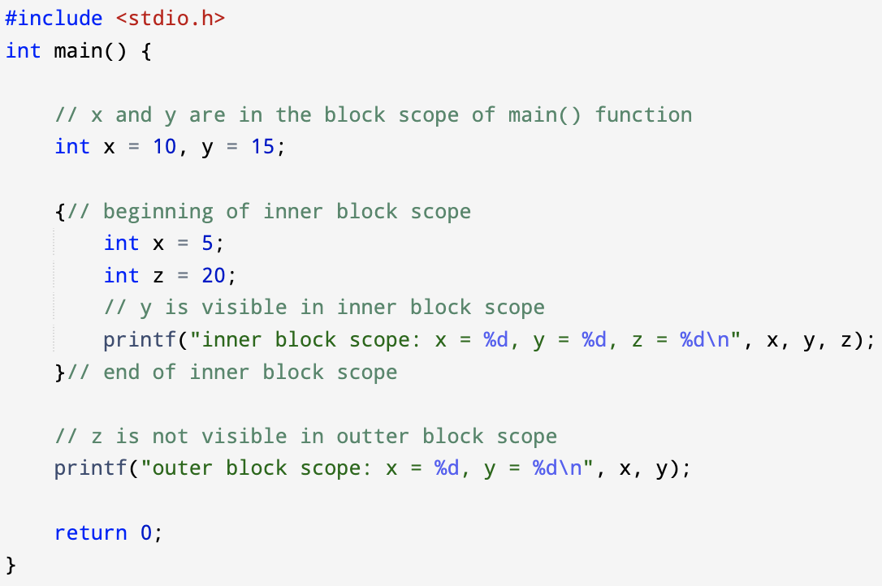

Scope – nested scopes
If two different entities named by the (1) same identifier are (2) in scope at the same time, and they (3) belong to the same name space, then the scopes are nested, and the declaration that appears in the inner scope hides the declaration that appears in the outer scope

Slide 10
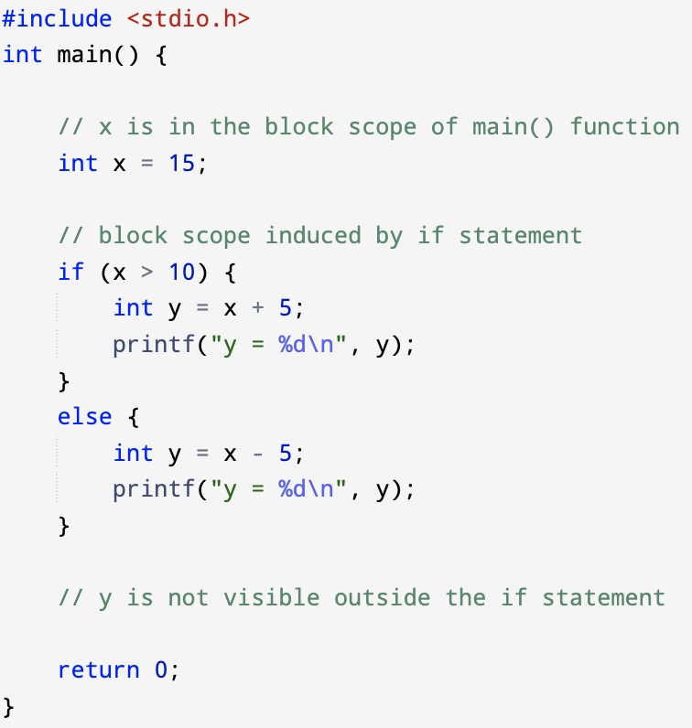
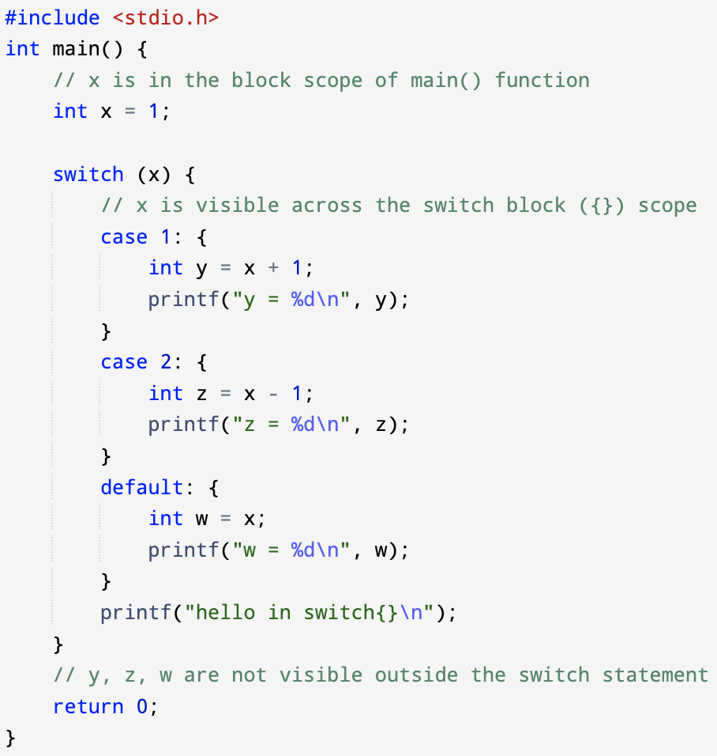
Block scope – if / switch statement
Both if & switch statement may include compound statement (a sequence of statements & declarations encapsuled by {})
they naturally induce the associated block scopes
while, do-while statement also have similar block scope
scope of y
scope of z
scope of w

Slide 11
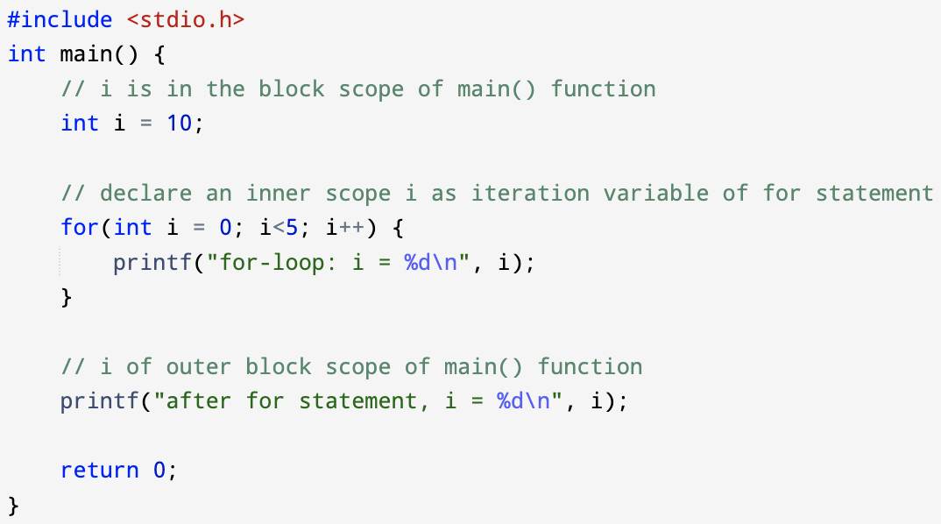
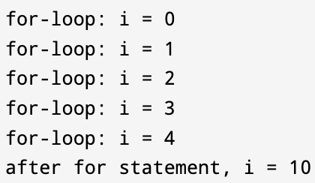
Block scope – for statement
for (init-clause (optional) ; cond-expression (optional); iteration-expression (optional)) statement
If the init-clause include declaration, then the declared identifier will be in the for-statement’s block scope, and nested scope is triggered if an identifier of same name space is in outer scope

Slide 12
File scope
The scope of any identifier declared outside of any block (including function body) or parameter list (of function prototype) begins at the point of declaration and ends at the end of the source file
File-scope identifiers have external linkage and static storage duration by default, this involves storage-class specifiers we will cover in later slides
Storage duration (lifetime of an object)
Linkage (visibility to other source files in multi-file programs)
Notes:
https://stackoverflow.com/questions/4239834/global-variables-in-c-are-static-or-not
https://en.cppreference.com/w/c/language/storage_duration

Slide 13
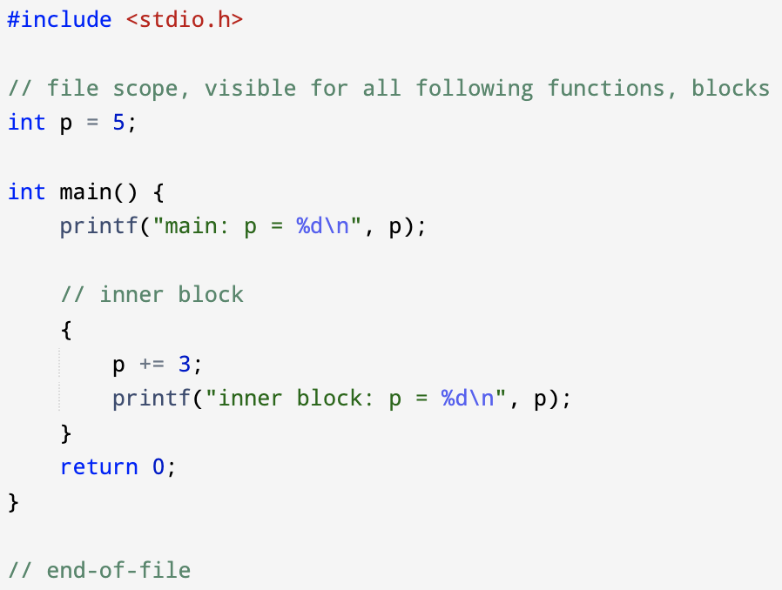

File scope - example
File scope variables can be accessed globally, starting from the point of declaration
scope of p

Slide 14
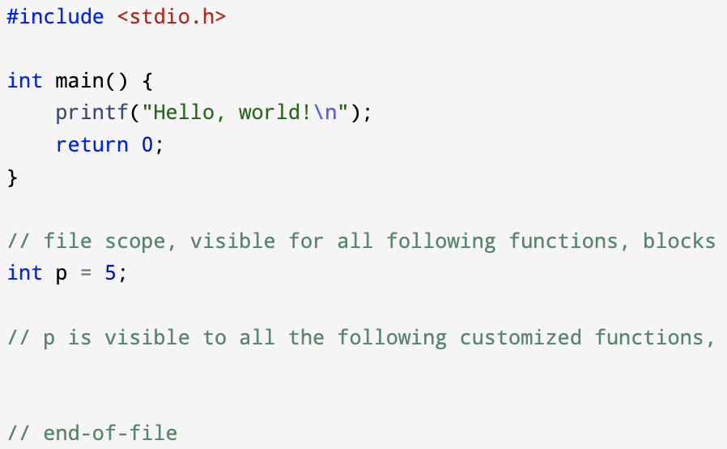
File scope - example
File scope variables can be accessed globally, starting from the point of declaration
scope of p

Slide 15
Function scope and Function Prototype scope
Scopes related to functions in C
Function scope
Input variables of a function are visible across the entire function body
Variables belong to different function scopes are not visible to each other
Function prototype scope
Scope within the function parameters list
More details in the following C function slides

